Slide 1
Workshop Abstract
Machine learning algorithms are increasingly being deployed in a wide range of domains, including medicine, advertising, criminal justice, speech recognition, and computer vision. These applications have the potential for significant impacts on our daily lives, but widespread acceptance by society has lagged behind due to the lack of trust. While the field of statistics has played an integral role in the machine learning revolution, much of its attention has focused on developing accurate algorithms. In addition to being accurate, however, trustworthy machine learning methods must also be fair, transparent, and interpretable. This workshop will bring together members of the statistical community to discuss recent progress and potential statistical solutions toward these understudied aspects of trustworthy machine learning.

Slide 2
Questions
I would like to include more:
Code Demos
Theoretical Directions
What do you think would be interesting?

Slide 3
Interpretability
Beyond Black and White (Boxes)
Kris Sankaran
Holmes Group Meeting
19 | January | 2024

Slide 4



Why Interpret?
We have unprecedented tools. How can we use them wisely?
Decision Making
Scientific Discovery
Design
Notes:
We’ve been doing all these things since before machine learning. ML has changed the way we do them.

Slide 5
Why Interpret?
Interpretability techniques guide us towards improved mental models of machine learning systems.
“it learns with each new experience, and I choose the word ‘experience’ intentionally as the machine gains consciousness” (HP62, N-I) -- quoted in Smith-Renner 2020

Slide 6
Why Interpret?
Interpretability techniques guide us towards improved mental models of machine learning systems.
“it learns with each new experience, and I choose the word ‘experience’ intentionally as the machine gains consciousness” (HP62, N-I) -- quoted in Smith-Renner 2020
It’s supposed to be just an early checkpoint in an effort Hassabis describes as the Apollo program of artificial intelligence, aimed at “solving intelligence, and then using that to solve everything else.” -- quoted in Simonite 2016

Slide 7
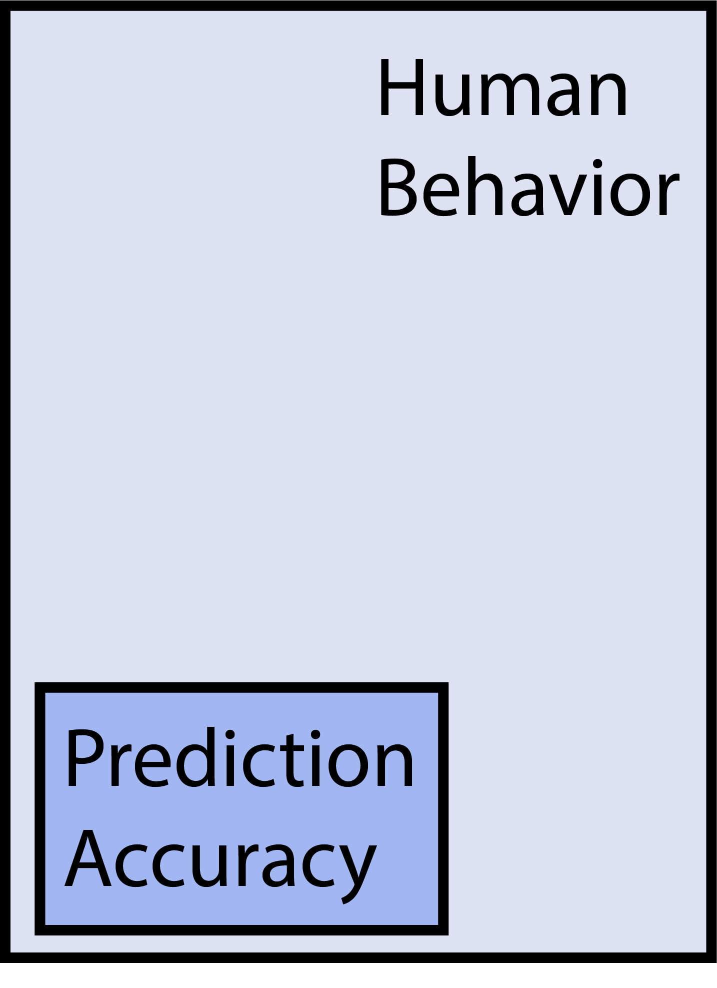
Historical Context
After a wave of interpretability methods, a period of critical self-reflection (Lipton 2018, Adebayo 2018, Murdoch 2019, Rudin 2019).
Success depends on people + machines, a step beyond the usual ML abstractions.
Systematic progress depends on shared tasks, objective evaluation, and substantive theory -- these are beginning to emerge.

Slide 8
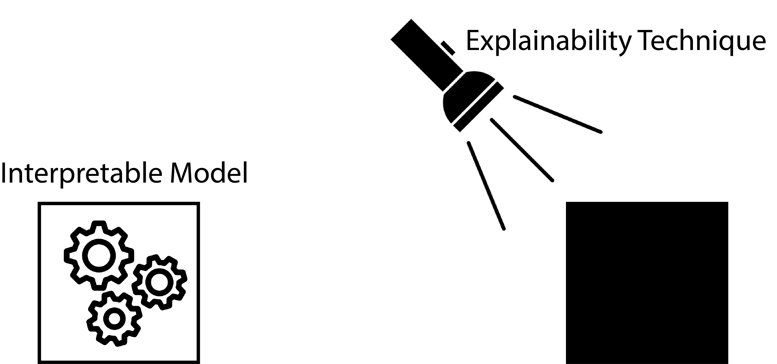
Vocabulary
Interpretable Model: A model that, by virtue of its design, is easy for its stakeholders to accurately describe and alter.
Explainability Technique: A method that shapes our mental models about black box systems.

Slide 9
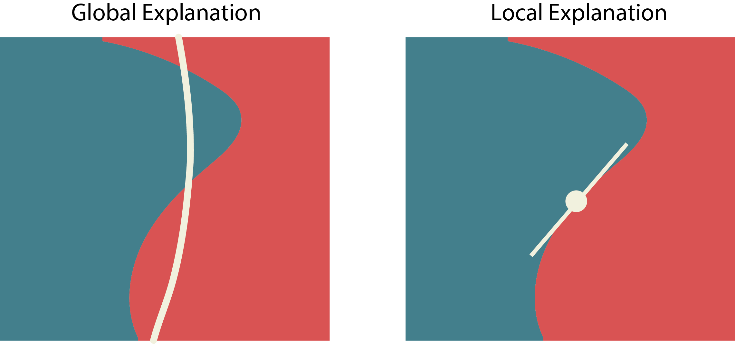
Vocabulary
Local Explanation: An artifact for reasoning about individual predictions.
Global Explanation: An artifact for reasoning about an entire model.

Slide 10
General Principles
 | Local | Global
Interpretable Models | Logic | Parsimony
Explanation Techniques | Perturbation | Summarization

Slide 11
General Principles
 | Local | Global
Interpretable Models | Logic | Parsimony
Explanation Techniques | Perturbation | Summarization
We will color code proposed methods, evaluation strategies, statistical connections, and critical perspectives.

Slide 12
Summarization

Slide 13
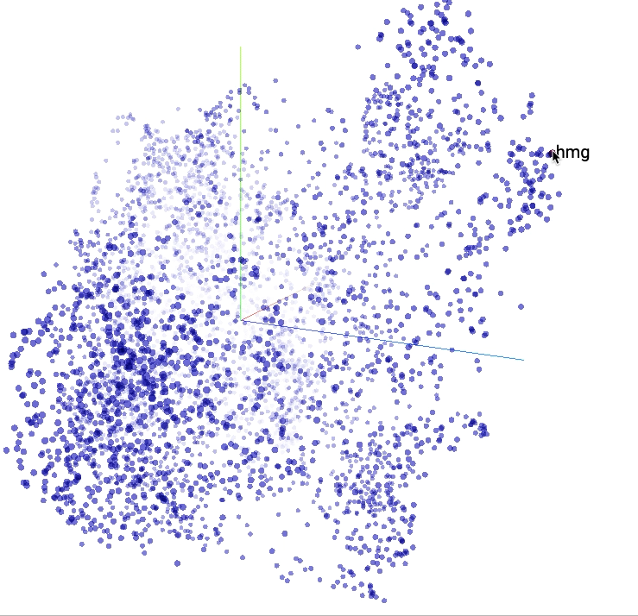
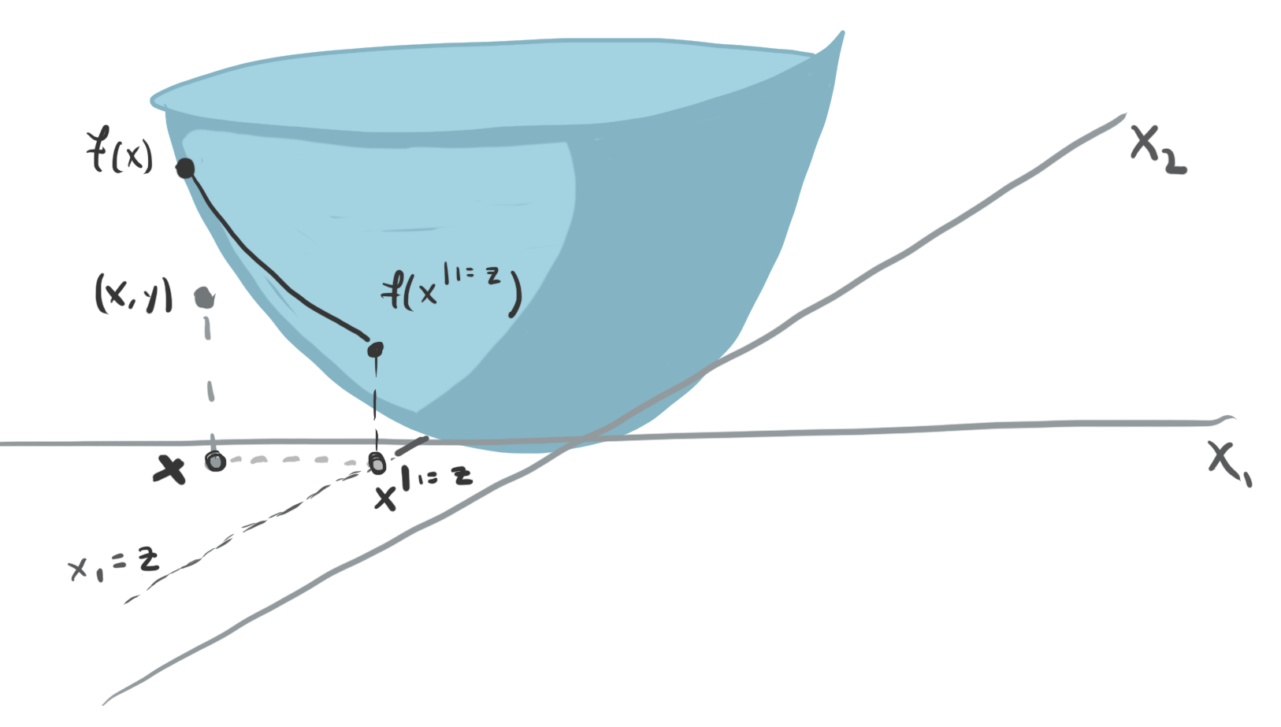
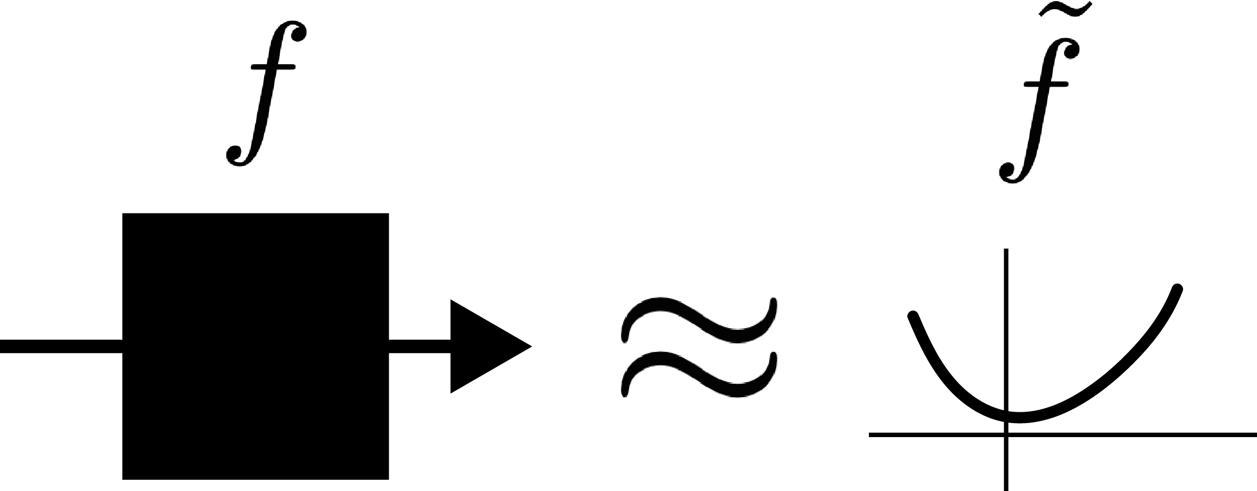
Main Idea
These techniques approximate black boxes to explain them.
Embedding Visualization
Partial Dependence
Distillation

Slide 14
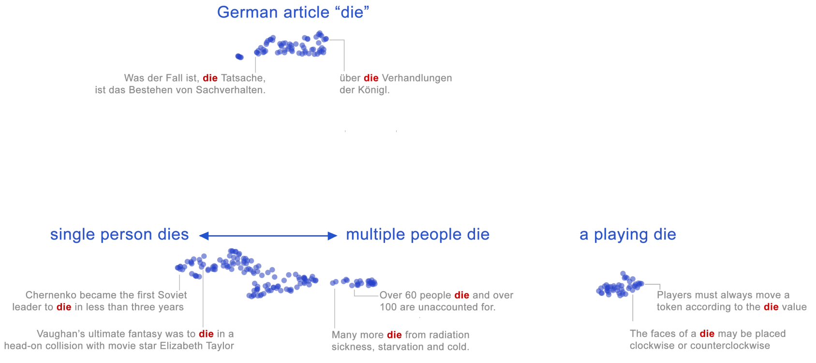
BERT Visualization
By applying PCA to the embeddings from a large language model, it’s possible to evaluate their linguistic properties (Coenen et al, 2019).
Notes:
A different kind of summarization looks at the latent representations learned by the model, rather than its regression surface.

Slide 15
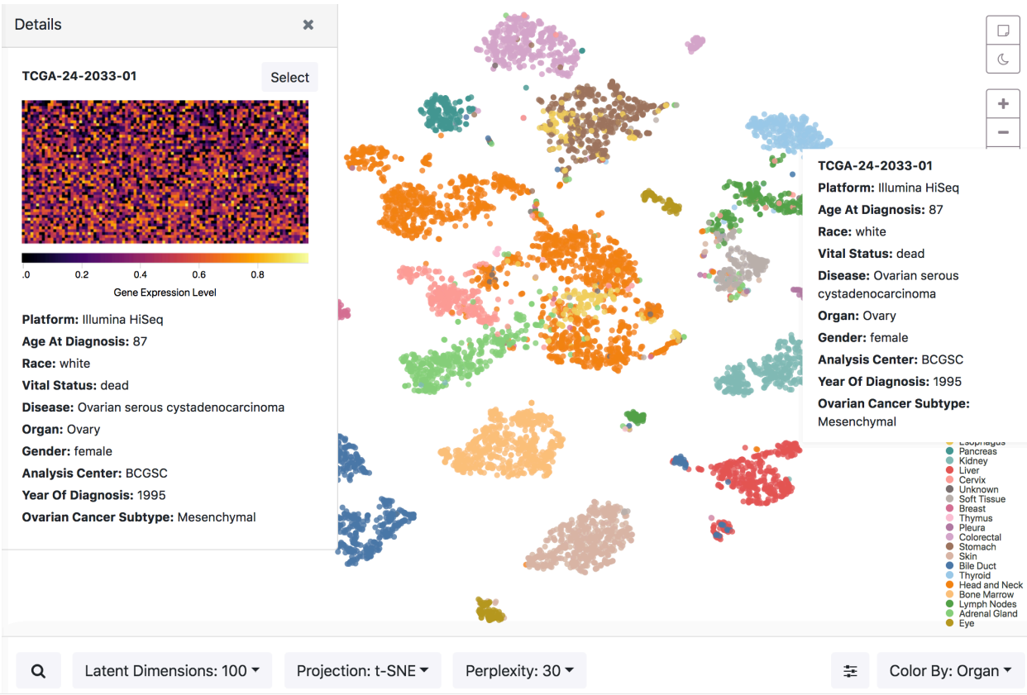
Transcriptomics Latent Spaces
This is from a tool for exploring the embedding space of a single cell transcriptomics dataset (Liu et al., 2019)

Slide 16
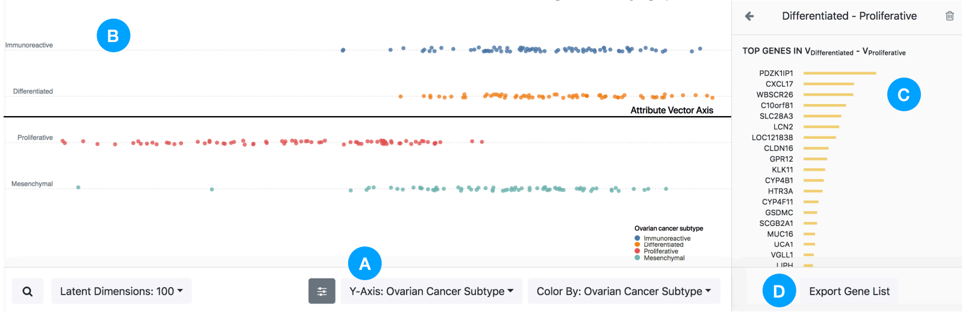
Transcriptomics Latent Spaces
The system makes it easy to project onto different user-specified axes and explore latent space “analogies.”

Slide 17
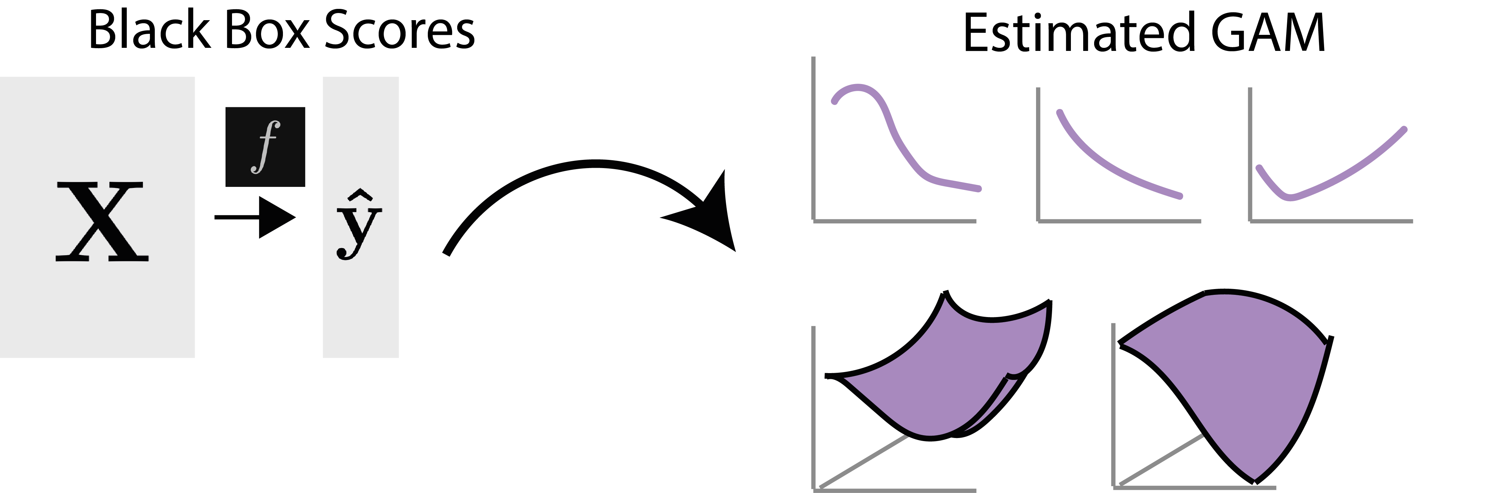
Distillation Trick
Distillation approximates a black box model with a transparent one. For example, Tan et al. (2018) audited proprietary policing and loan models using iterative generalized additive models.

Slide 18
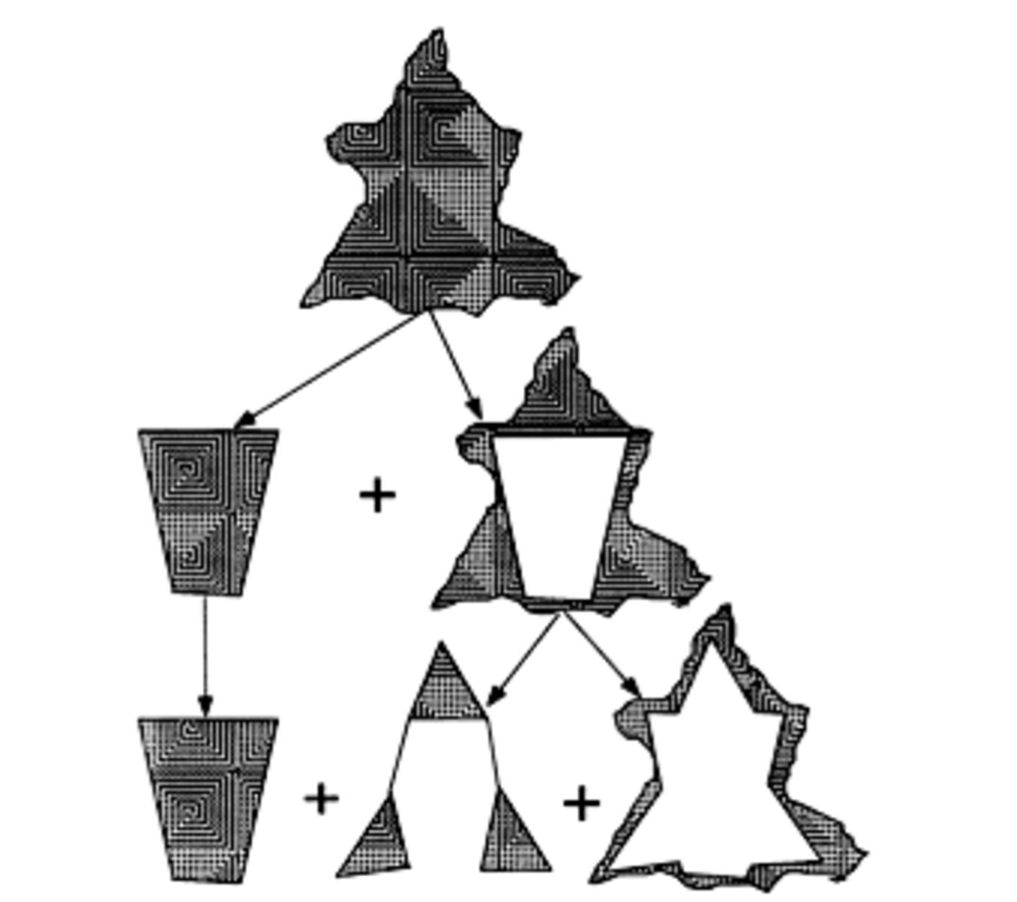
Iterative Structuration
One perspective is that we are treating the black box itself as the object of data analysis.
It is important to assess the quality of the approximation.
From (Tukey, 1977). See also (Holmes, 1993).

Slide 19
Regulation
When models are complex, or when they are proprietary, then their predictions and embeddings must themselves be treated as data. There may be legal mechanisms to avoid this situation.
As governments seek to regulate machine learning and AI, summarization techniques are becoming one method for implementing audits (Shen et al. 2023).

Slide 20
Parsimony

Slide 21
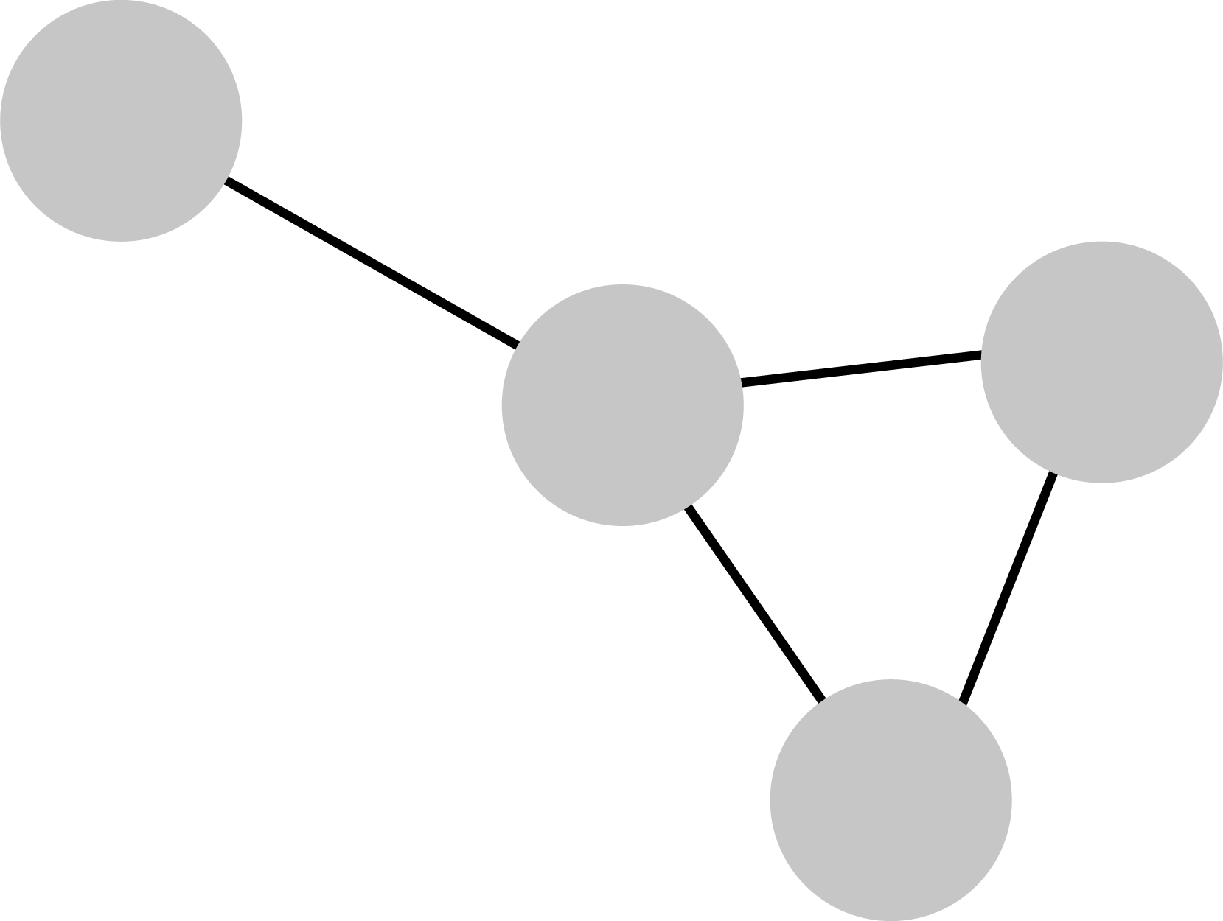
Main Idea
If a model,
has relatively few components
if each component is simple, and
if they are connected in clear ways
then the model will be inherently interpretable.

Slide 22
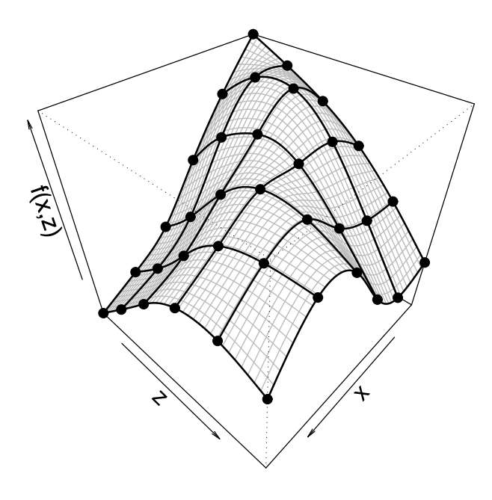
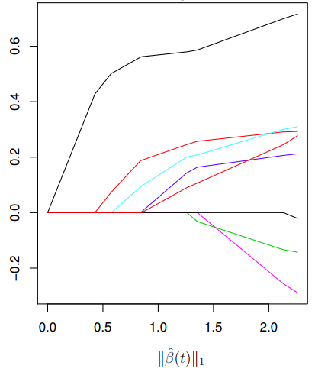
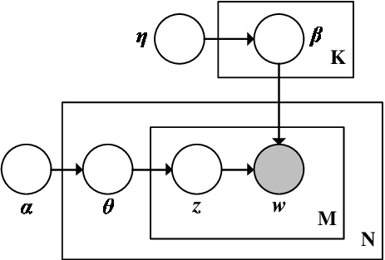
Statistical Tradition
Sparse Models
Additive Models
Graphical Models
Parsimonious…
coefficients
interactions
sampling steps

Slide 23
Asthma Example
Caruana et al. (2015) trained a generalized additive model to predict whether it was safe to discharge patients who were recovering from pneumonia.
They found that patients who had asthma had lower probability of death. In the training data, they tended to be treated more aggressively. They should not be discharged early!

Slide 24
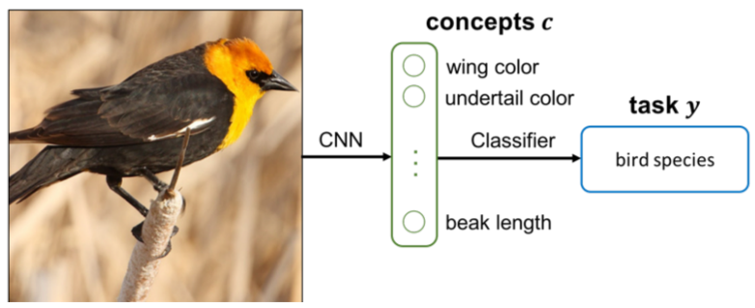
Concept Bottlenecks
A less traditional approach achieves parsimony by reducing the arbitrary feature space to a set of human-interpretable concepts (Koh, 2020). This requires dense, concept-level annotations for every sample.

Slide 25
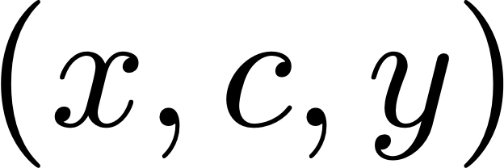
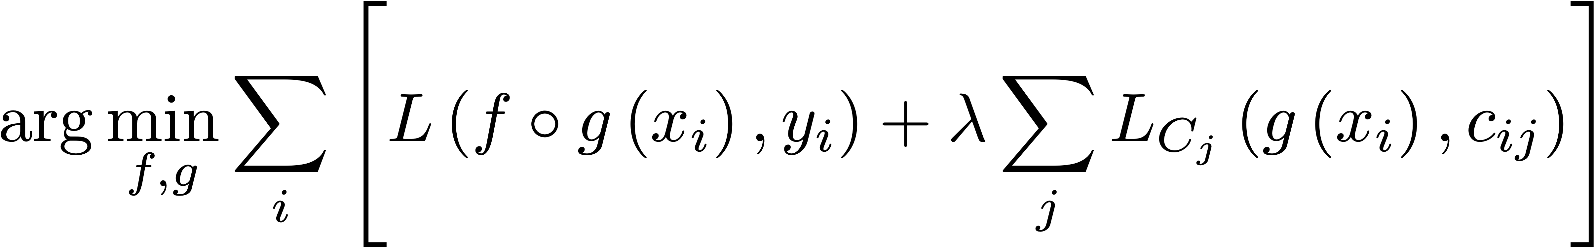
Concept Bottlenecks
We can train this models using tuples and objective function:

Slide 26
Logic

Slide 27
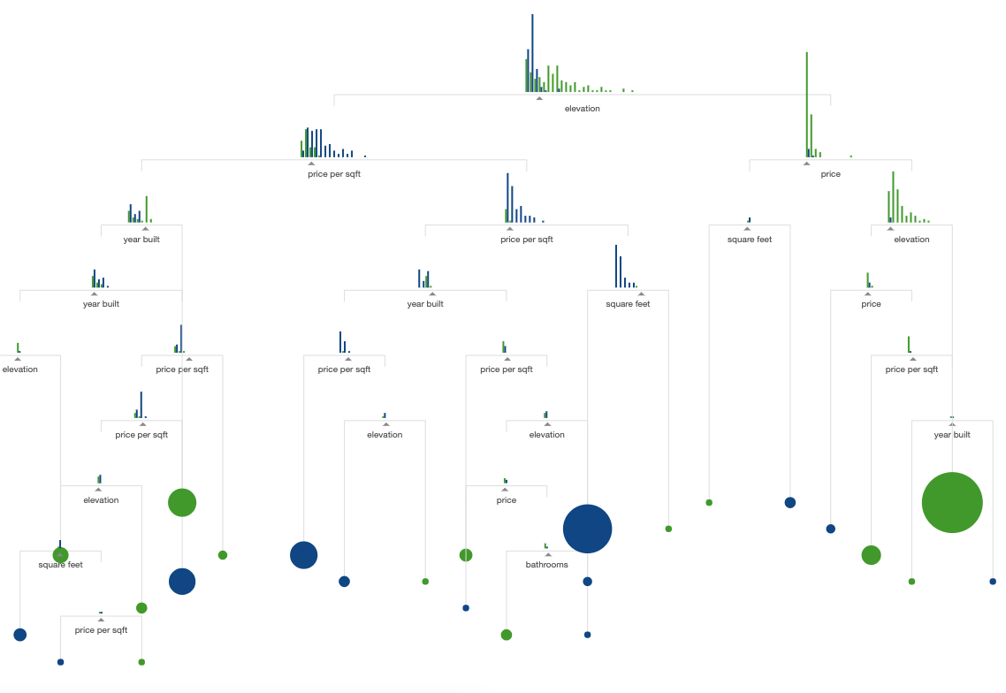
Main Idea
Let’s transition from global to local explanations.
To understand a decision, it helps to trace out every step that was taken.
(r2d3, 2015)

Slide 28
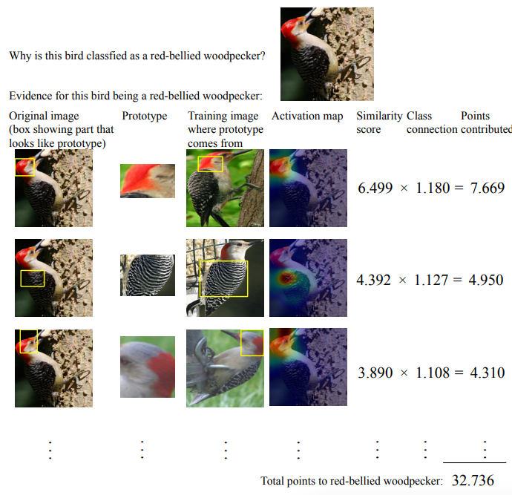
Prototype Patch Networks
(Chen 2019) uses CNN features to compare new patches with those across the training data.
Evidence across patches is aggregated to arrive at a final classification.

Slide 29
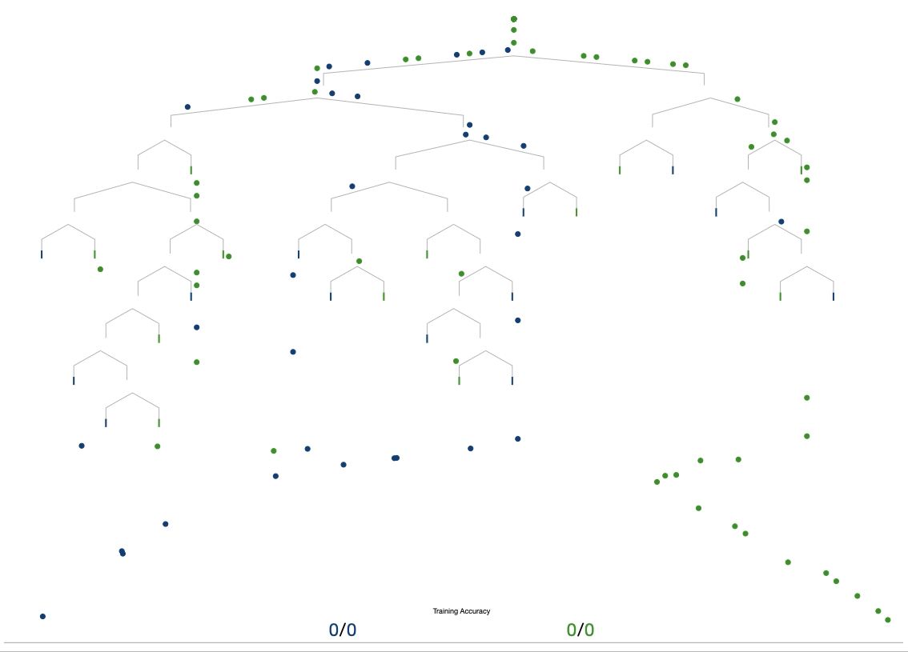
Simulatability
Can a person recapitulate the reasoning process of a model to arrive at the same decision, and how long would it take?
(By this definition, even linear models may be uninterpretable)

Slide 30
Perturbation

Slide 31
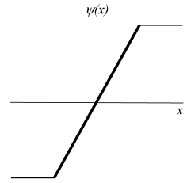
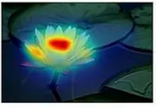
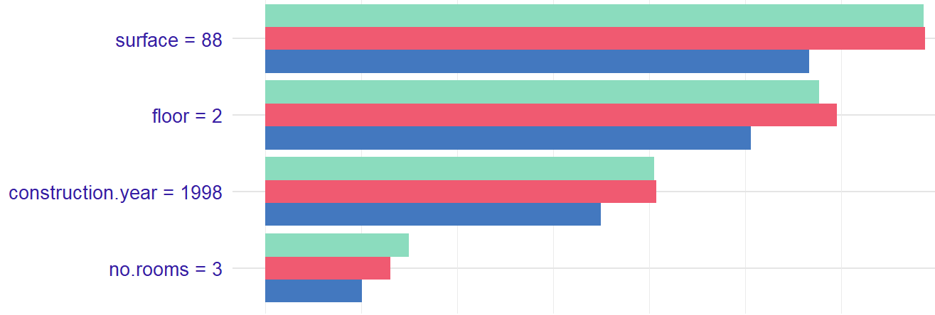
Main Idea
If you want an explanation for a generic model’s decision, one approach is to perturb that input and see how the prediction could have changed.
Influence Functions
Saliency Maps
Local Variable Importance

Slide 32
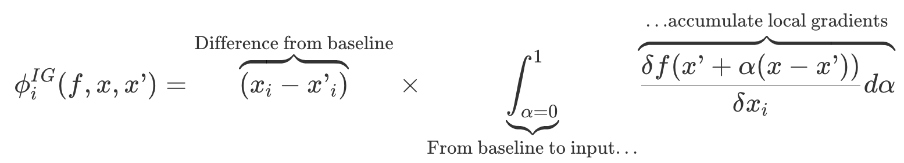
Integrated Gradients
One idea is to perturb a reference image towards a sample and study how the classification probability changes (Sundararajan 2017, Sturmfels 2020).

Slide 33
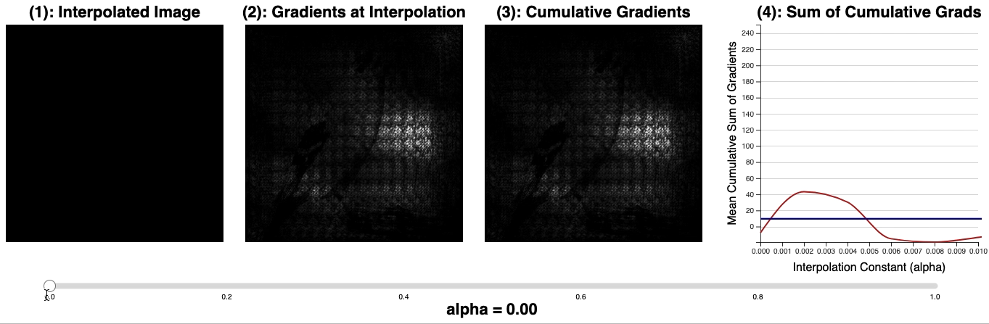
Integrated Gradients

Slide 34
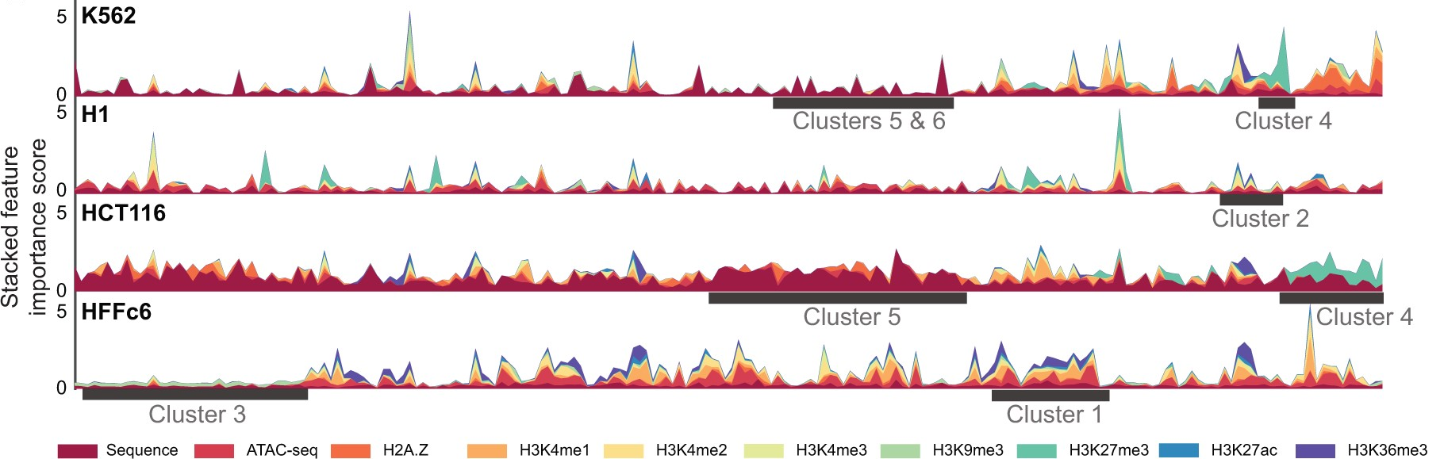
Chromatin Organization
Yang et al. (2023) used integrated gradients to assign base-pair level importances in a transformer model to predict chromatin localization.

Slide 35
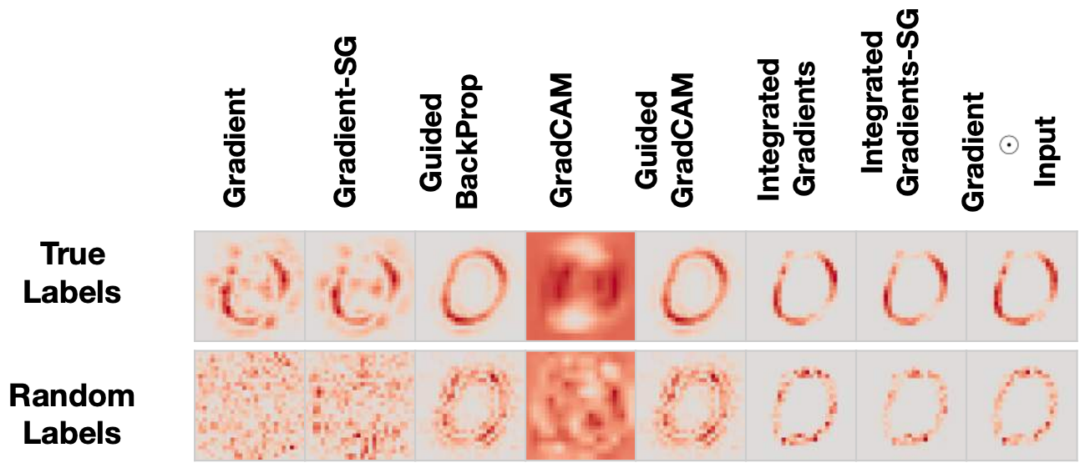
Sanity Checks
Evaluating local explanations is notoriously subjective. Some researchers have proposed automatic “sanity checks” (Adebayo et al. 2018).

Slide 36
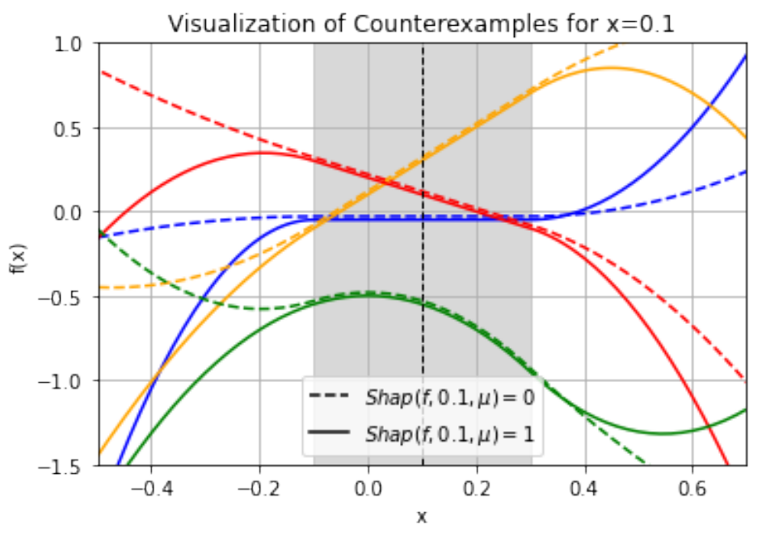
Impossibility Theorems
Functions that are identical within a neighborhood can receive very different explanations (Bilodeau et al., 2023).

Slide 37
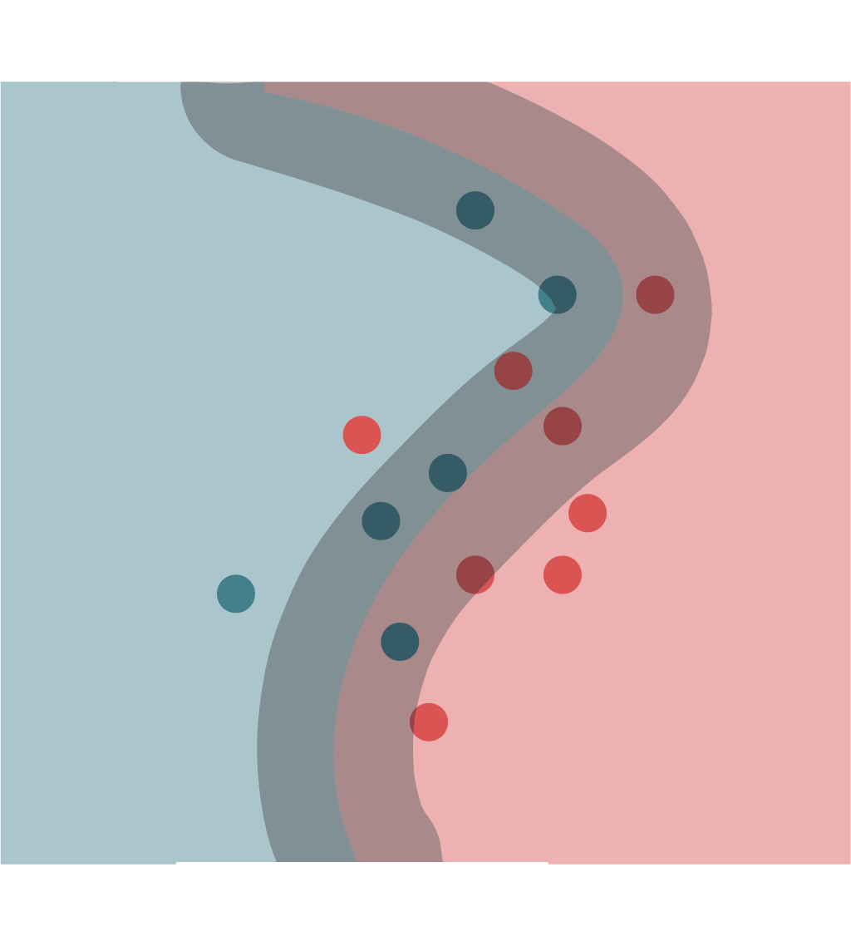
Counterfactual Reasoning
A related local explanation technique asks how predictions change when modifying an input.
Contrast sets: Inputs that are close to another, but with opposite predictions. These can help explore the decision boundary in high-dimensional problems.

Slide 38
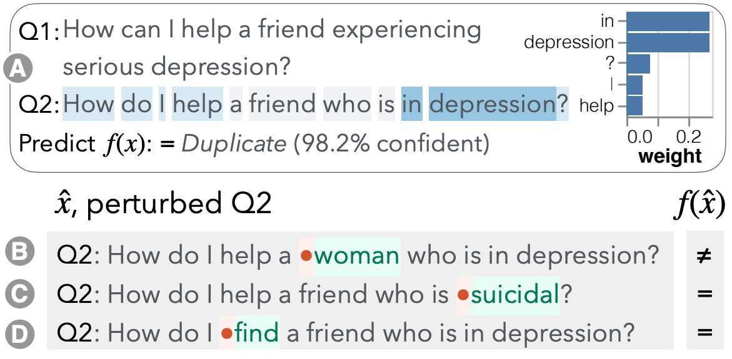
Counterfactual Reasoning
Contrast sets: Inputs that are close to another, but with opposite predictions. These can help explore the decision boundary in high-dimensional problems.

Slide 39
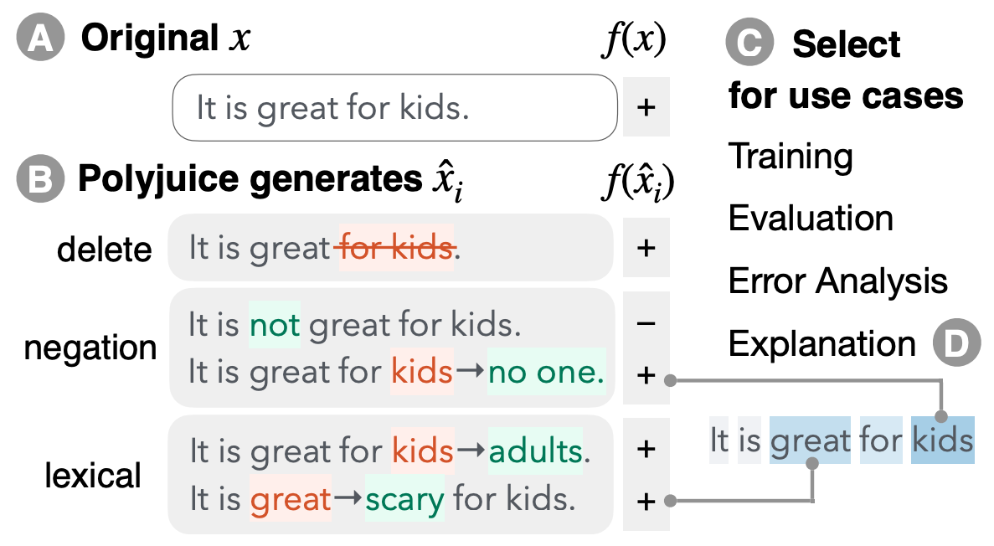
Polyjuice
Writing counterfactuals is time-consuming, and automatic generation often misses context-dependent counterfactuals.
Wu et al. (2021) fine-tuned a language model to support user-guided counterfactual generation.

Slide 40
Editing
Related to counterfactuals, you can ask users to “flip” model predictions by editing inputs, after first training them with (input, explanation, label) tuples.
This is often easier than simulating a model’s prediction. For many types of explanations, users are no better at flipping labels compared to when the explanations are omitted (Arora et al., 2021).

Slide 41
Interactivity and Augmentation

Slide 42
Oversight and Insight (Doshi-Velez 2023)
We use interpretable models and explainability techniques to audit and learn from machine learning models.
Good ML models are not enough: We also want good mental models.
It’s not possible to measure this type of improvement in a vacuum. Some audiences where these methods have been evaluated: Data scientists, graduate students, course students, Mechanical Turk.

Slide 43

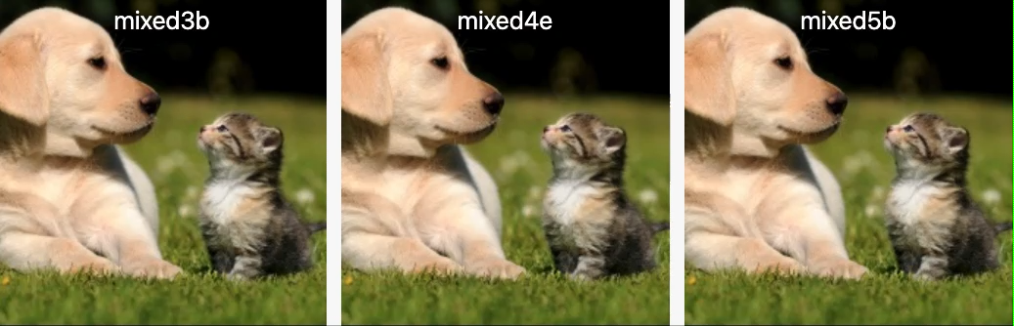
Intelligence Augmentation
The oversight/insight paradigm assumes batch mode modeling.
Augmentation is more focused on interactive problem solving (Carter and Nielsen, 2017, Fong et al. 2021).

Slide 44
Shared Languages
Effective augmentation tools serve as a medium between human and computational representations (e.g., grammar of graphics).
More interpretable tools allow us to communicate more clearly with one another and with our machines (Kim 2022, Heer 2022).
Understanding the properties of this language will allow us to design them more effectively.

Slide 45
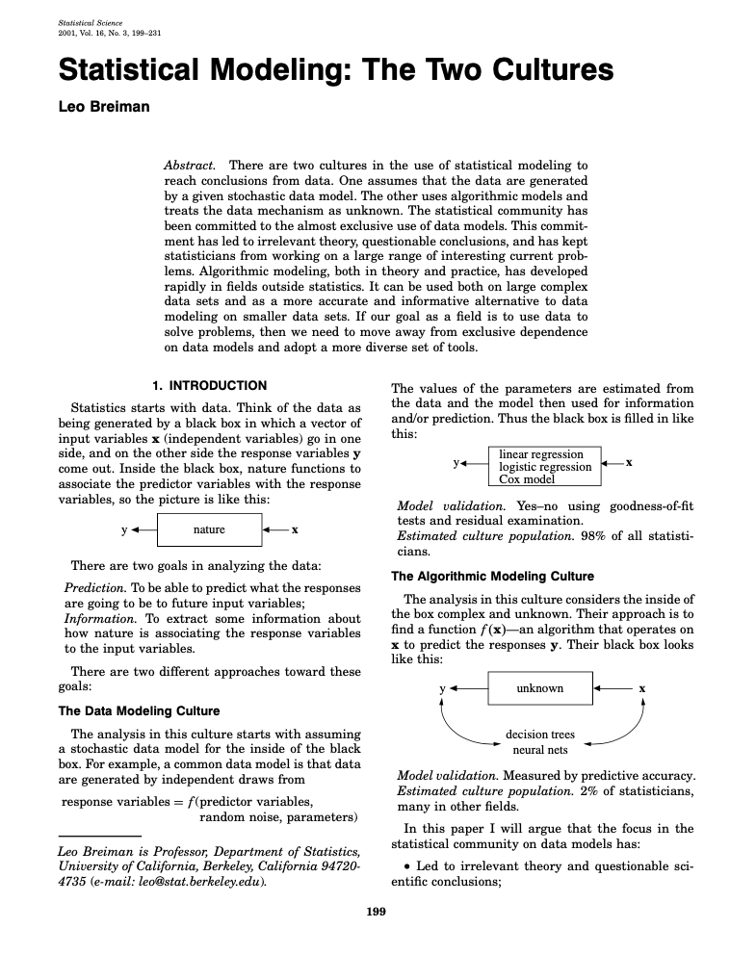
Multicultural Data Science?
To develop these tools, we will have to move beyond the two cultures.

Slide 46
Supplemental Slides

Slide 47
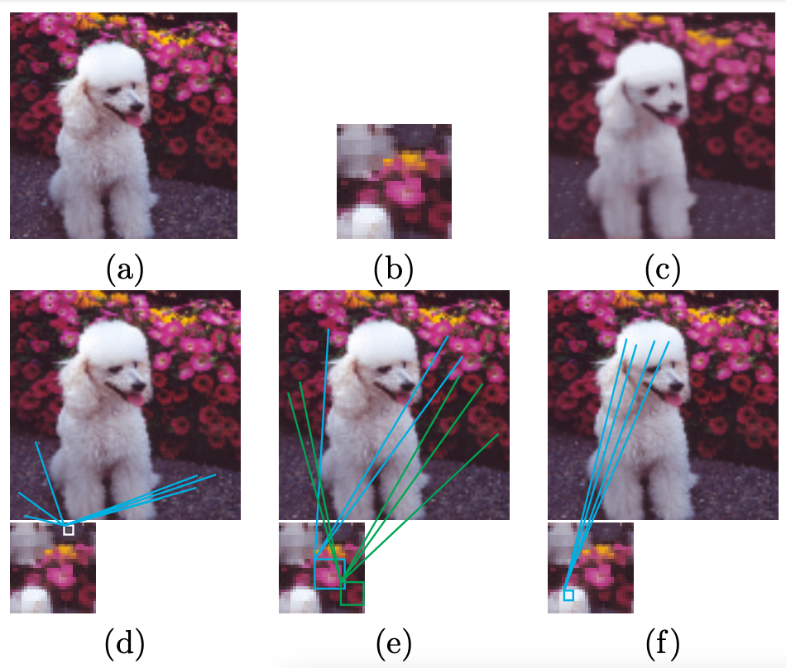
Epitome Models
A related idea in generative models is to construct a compressed image (“epitome”) that captures the essential image features of the input.
The original image can be reconstructed by averaging patches from the epitome.

